Slide 1
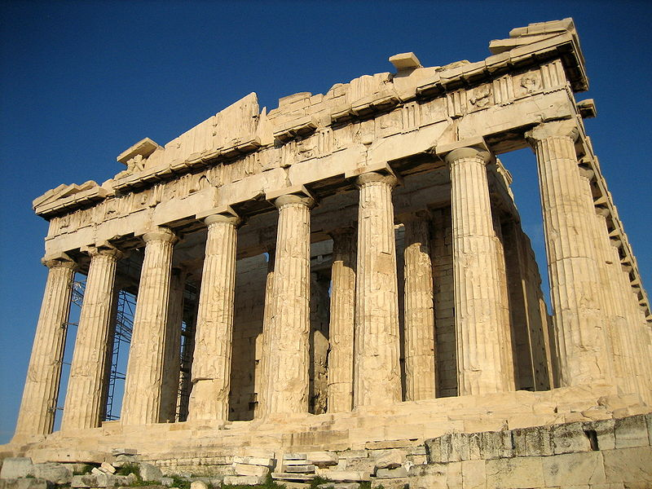
When you think about ancient Greece, what do you think of?

Slide 2

What is Philosophy?

Slide 3
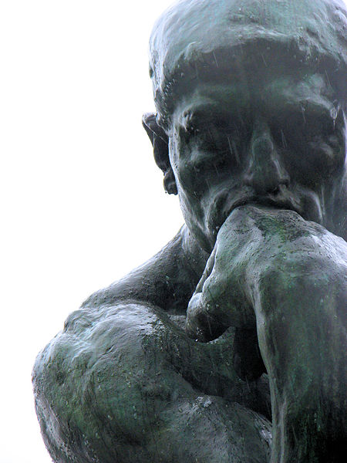
The word “Philosophy” comes from the Greek word “Philosophia” which literally means:
Love of Wisdom

Slide 4
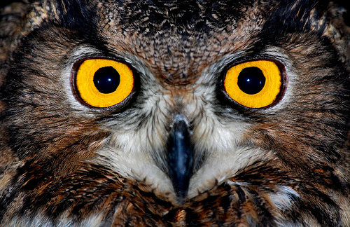
Wisdom is making the best use of knowledge.

Slide 5
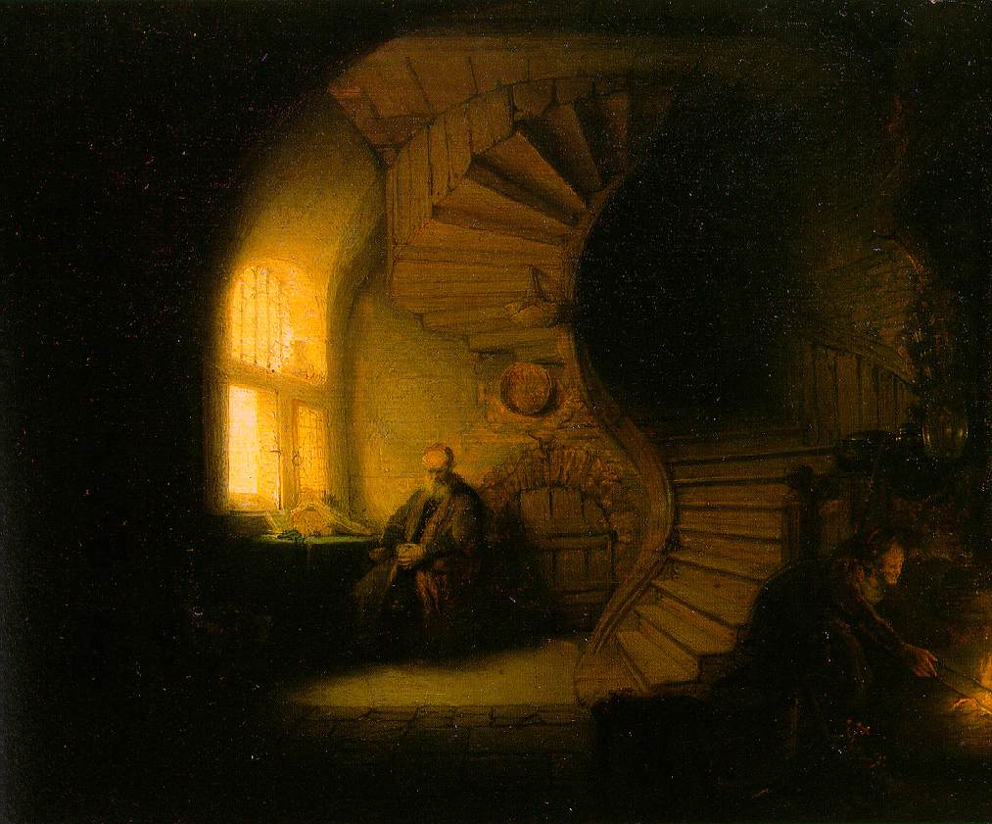
What Do Philosophers Do?
They Attempt to answer questions, like:
How should I live my life?
What is reality?
Who am I?
How do we know what we know?
Why am I here?
What is right and what is wrong?
Where do we come from?
What is the purpose of life?

Slide 6
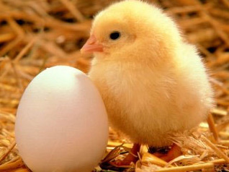
What came first?

Slide 7
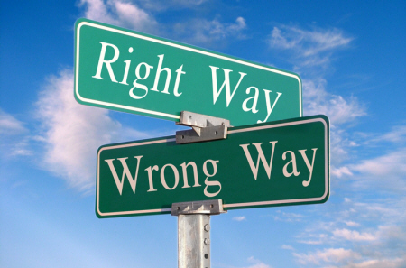
In philosophy, there aren’t always “right” or “wrong” answers

Slide 8
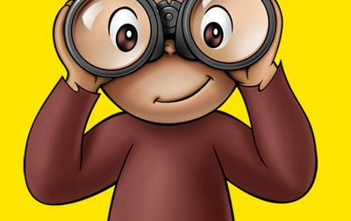
The only thing required to be a good philosopher is CURIOSITY!

Slide 9
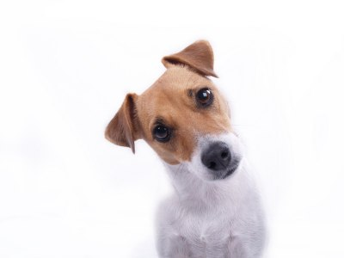
Why is philosophy important?

Slide 10
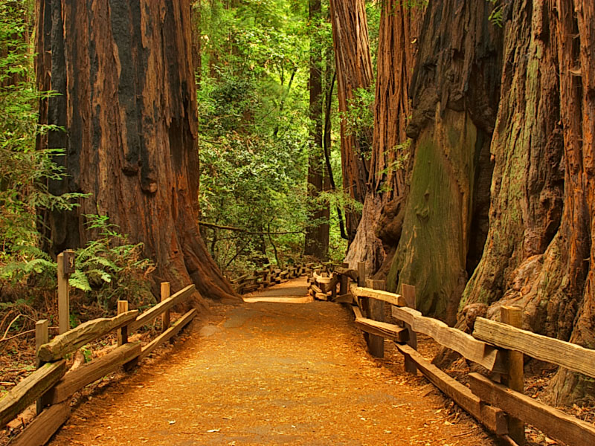
Our answers to the questions determine our path in life!

Slide 11

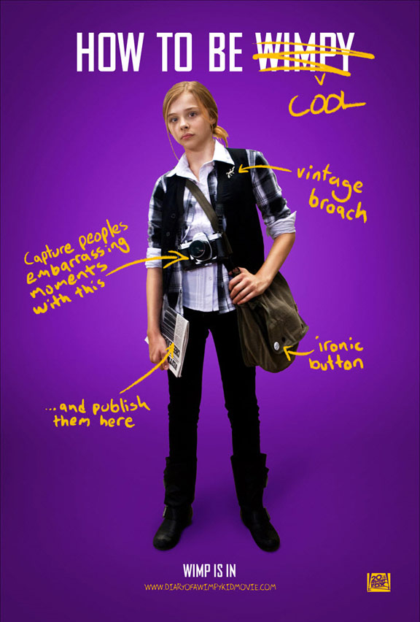
A philosophy you may recognize. . .
What philosophical question are these kids trying to answer?

Slide 12
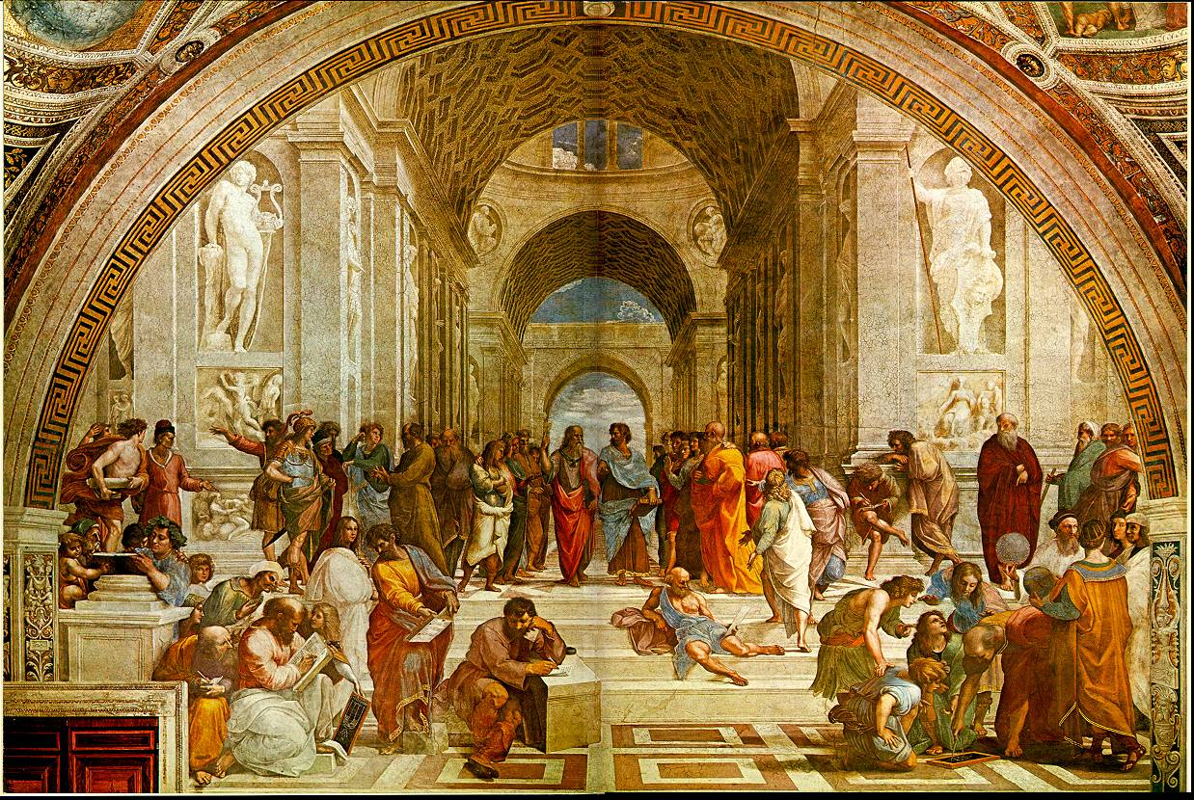
The Great Philosophers of Ancient Greece

Slide 13
Greek Philosophy Overview
the Greeks were the first people to separate ideas and knowledge from religion and superstition
Believed humans could use reason to understand the world around them

Slide 14
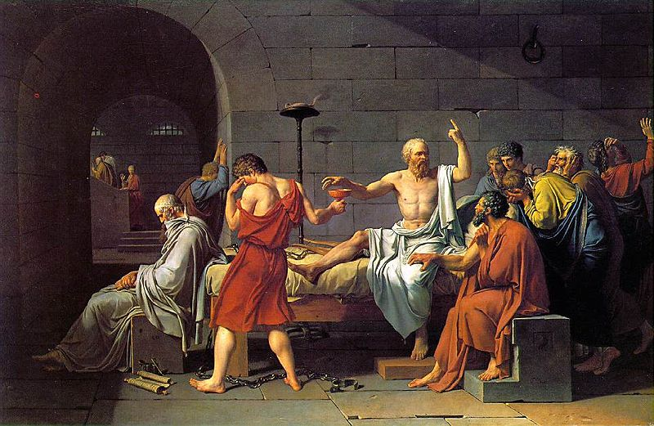

Socrates (Sock-Ruh-Tees)
470-399 BC
Socratic Method – A way of asking questions to guide one to truth. Insight cannot be taught, it must come from within.
“One thing only I know, and that is that I know nothing.”
Political leaders accused him of teaching kids and teenagers to rebel against the state. He was told he could either leave Athens forever or drink poisonous hemlock.
He chose the hemlock.

Slide 15
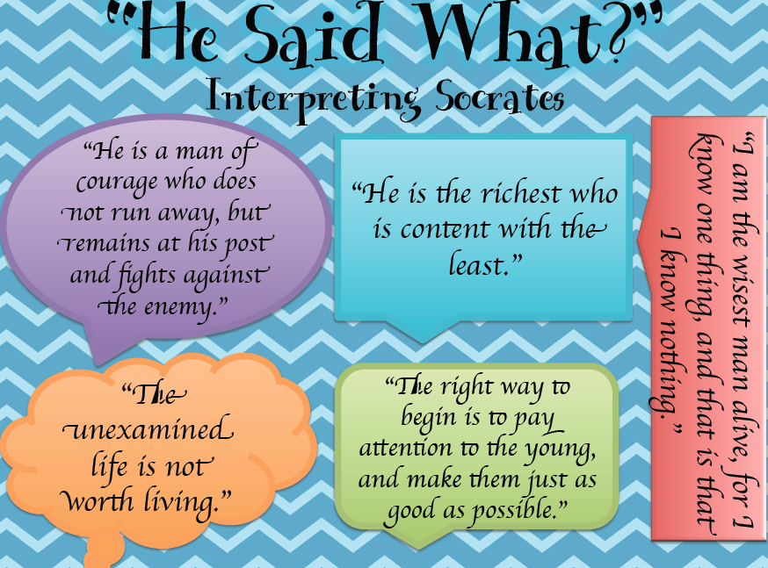

Slide 16
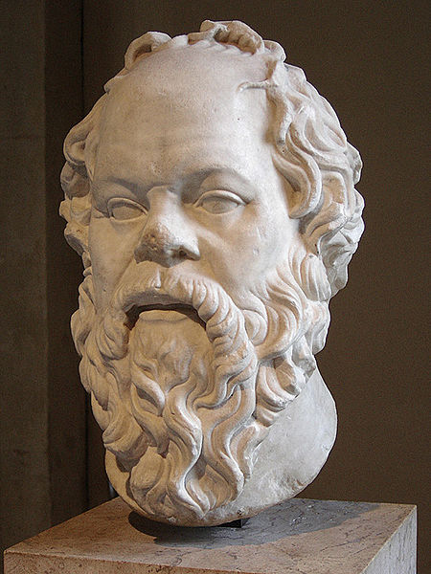
Socrates Discussion Questions
Can you live a happy life if you continually do things you know deep down are wrong?
Do you think that liars, cheaters, and thieves are aware that those things are wrong?
Do you think liars, cheaters, and thieves are happy?

Slide 17
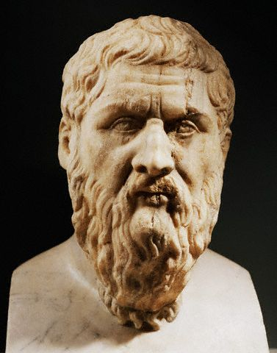

Socrates never wrote anything down, so everything that we know of him is based on what his student, Plato, wrote down.
Plato believed that everything that exists first begins as an idea.
Plato (Play-Dough)
428-348 BC

Slide 18
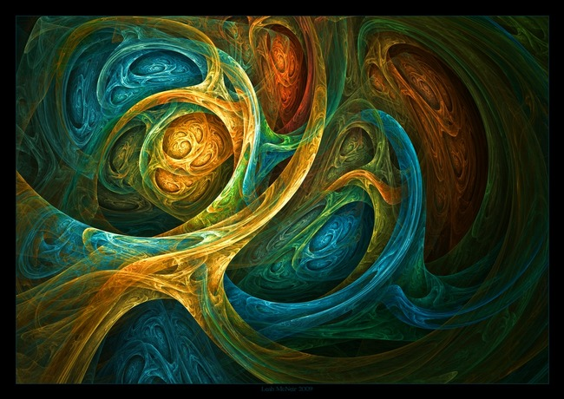
Plato believed that before the universe was created, it first existed as an idea in a spiritual world.
He called this the “World of Ideas.”
He believed that each of us has access to this world through a door in our minds, which we enter into during the creative process.

Slide 19
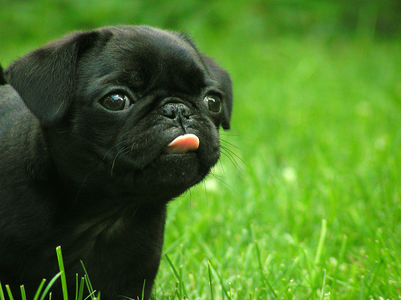
Picture a dog in your mind
This kind of experiment has resulted in much disagreement with Plato’s theory
Does the dog look like this?
Does the dog in your mind exist?

Slide 20
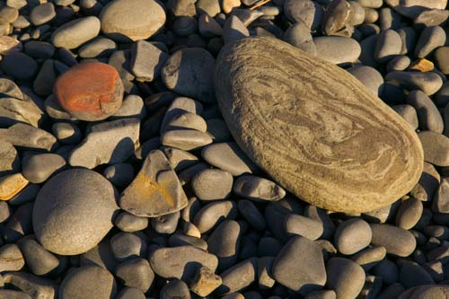
What is this a picture of?
How do you know?
What if. . .

Slide 21

We took a hammer. . .

Slide 22
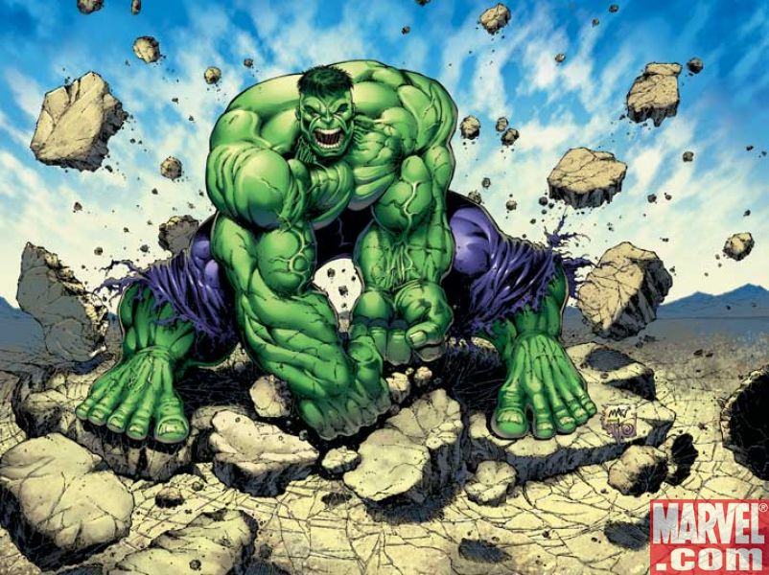
And SMASHED the rocks into smithereens. . .

Slide 23
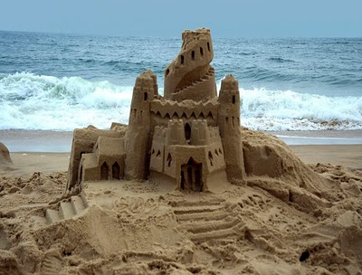
And built a sand castle out of them. . .
Do the rocks still exist?
Plato would say that we can never have true knowledge of anything that is changeable; we can only have opinions about them.

Slide 24
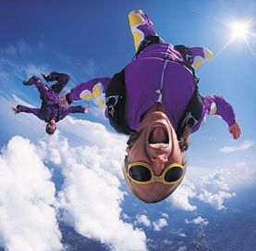
This includes OURSELVES!!!
Do you agree or disagree?

Slide 25
Plato also did not believe in democracy.
Philosophers = Rulers
2. Warriors = Protection
3. Everybody else = Provide food, shelter, clothing, etc.
He believed that the structure of society should consist of 3 levels

Slide 26
Plato created the legendary “School of Athens” where students could learn about the “world of ideas” and try to use it to create a perfect government. Plato called this perfect government “The Republic.”
Who’s This Guy?
Plato

Slide 27
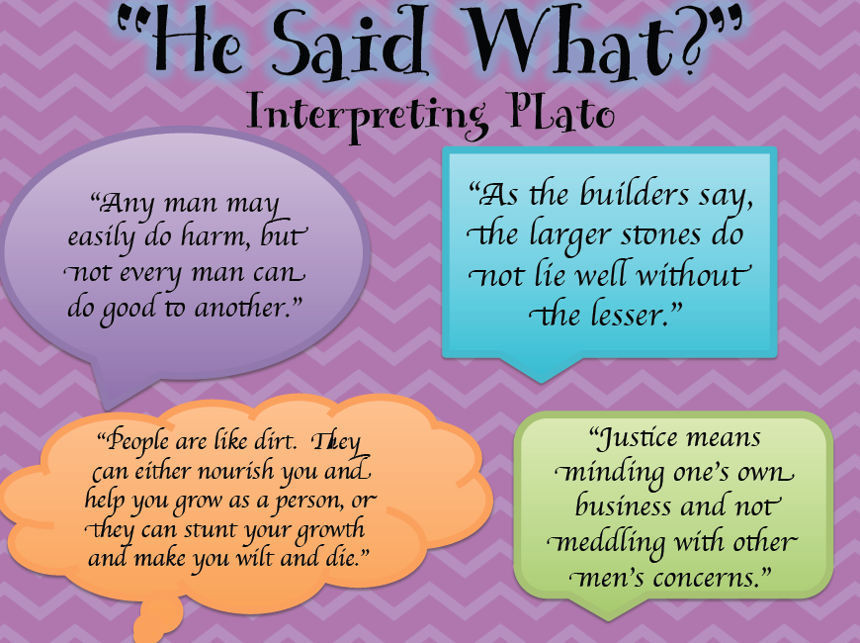

Slide 28
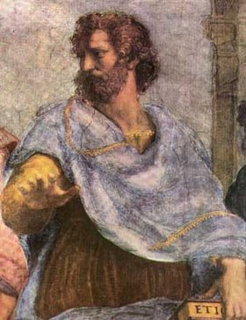
Wrote more than 200 books with topics ranging from the weather to human behavior
Sought truth through a systematic scientific approach.
Believed strongly in teaching what he called the “Golden Mean.”
Aristotle (Air-iss-tottle)
384-322 BC
What is the “Golden Mean?”

Slide 29
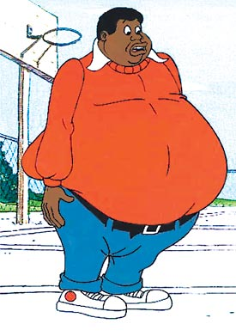
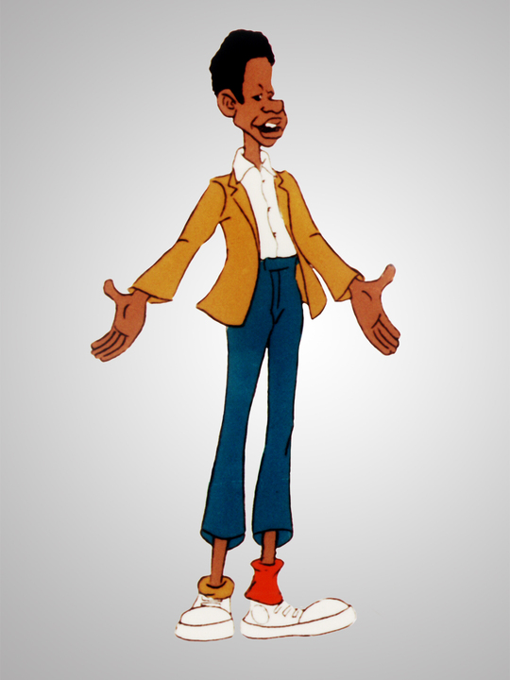
The “Golden Mean” is. . .
Not eating too much
Not eating too little

Slide 30
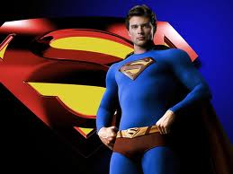
But eating just enough to stay healthy!

Slide 31
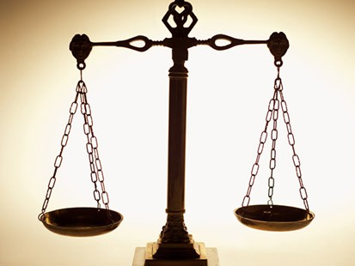
This balance is the
“Golden Mean”
Aristotle believed that you should strive to find balance in your life.

Slide 32
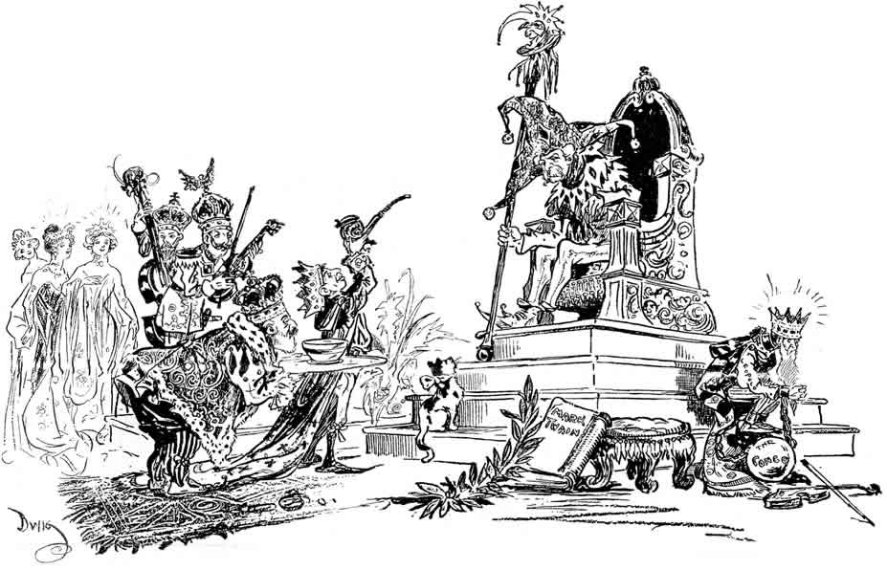
Aristotle disagreed with his teacher Plato, in that government should not be ruled by one person!

Slide 33
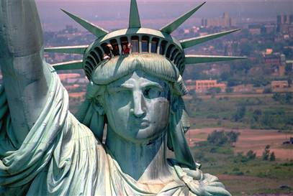
Nor did Aristotle believe that government should be a democracy

Slide 34

But he believed that government should be a blend, or mixture of both

Slide 35

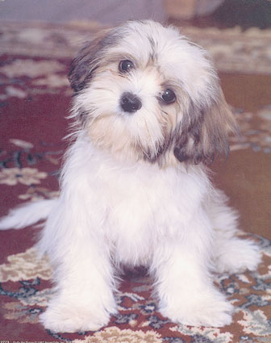
Aristotle also disagreed with Plato about the spirit world, or the “World of Ideas.”
Plato would say. . .
But why study nature?
“Dogs exist whether or not the idea comes first or second. Either way, we must study what nature creates!”

Slide 36
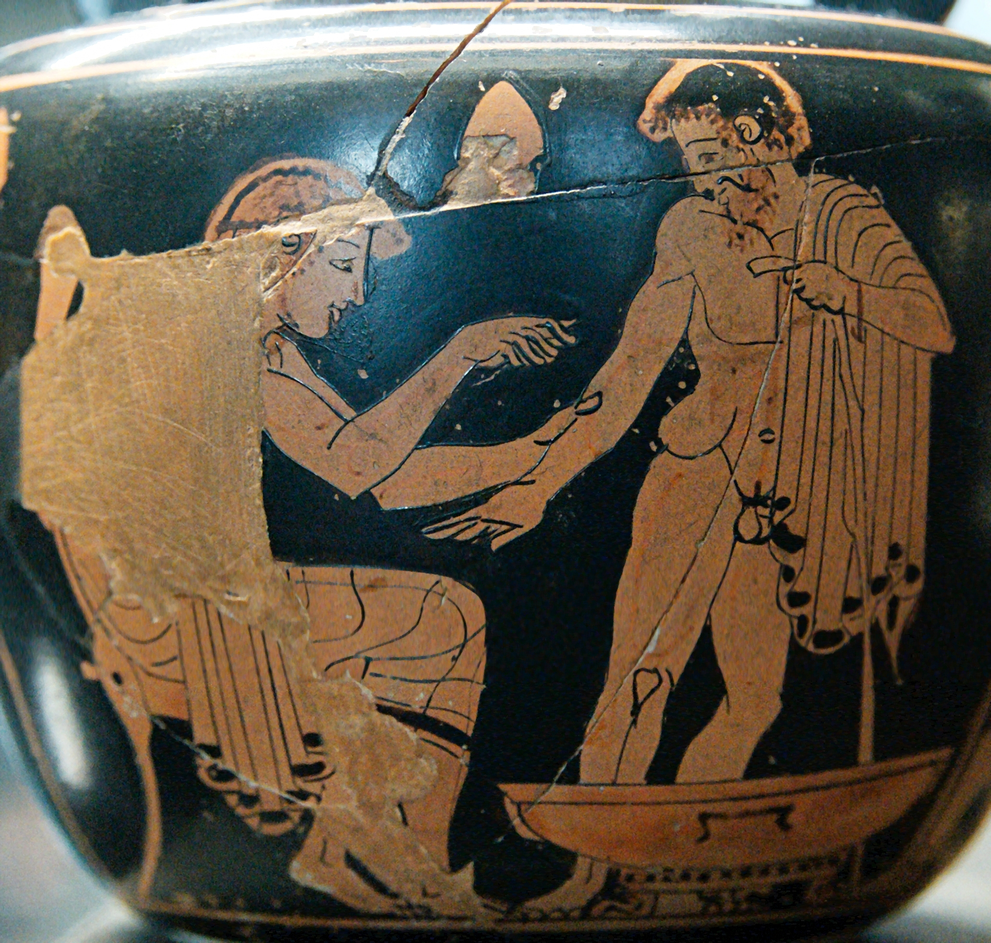
One reason is that by studying nature, the Greeks were able to discover new medicines

Slide 37
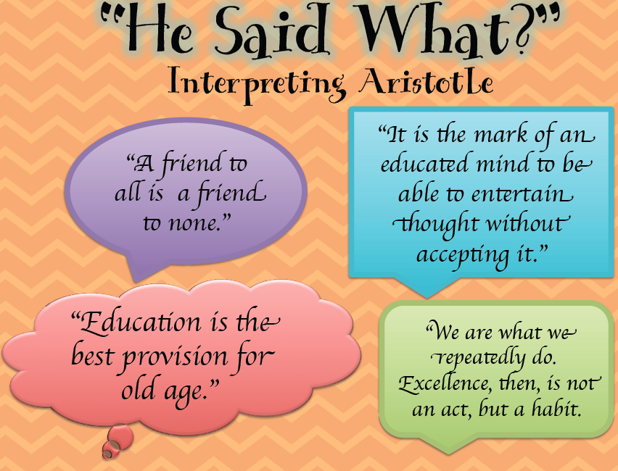

Slide 38
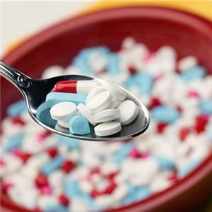
Today, scientists continue to study nature to advance our knowledge of medicine
Why else should we study nature?

Slide 39

Philosophy has transformed the world. . .
The End
How will it transform you?

